Slide 1
Predicting Accident Severity

Slide 2
Predicting Accident Severity is Valuable
Traffic Management division are interested in accurate prediction of accident severity to improve road safety strategies.
The study can also raise awareness to the general public population by highlighting which factors to focus on while driving.
In addition, road engineers and consultants will have better insights on road conditions when designing new roads and associated traffic lights.

Slide 3
Data Source
The used Dataset has been provided by Seattle Traffic Management Division (SDOT) under link:
Data-Collisions.csv
Data is updated weekly by SDOT and contains observations from 2004 to Present timeframe
Full explanation for Dataset can be found at link:
Data-Collisions-Metadata.pdf

Slide 4
Data Cleaning
dropped all rows which has empty values under target variable “SEVERITYCODE”
"ADDRTYPE": replace by most frequently address type “Block”
INTKEY: replace by 0 for "no intersection"
"COLLISIONTYPE": remove rows as collision type is important for severity prediction
"JUNCTIONTYPE": replace by most frequent “"Mid-Block (not related to intersection)"”
"UNDERINFL": convert "N" to "0" and "Y" to "1", and replace by most frequent value “N”
"WEATHER": replace by "unknown" for empty unknown values
"ROADCOND": replace by "unknown" for empty unknown values
"LIGHTCOND": replace by "unknown" for empty unknown values
"ST_COLCODE": replace by most frequent Collision code
"ST_COLDESC": will leave as is ,it describes ST_COLCODE

Slide 5
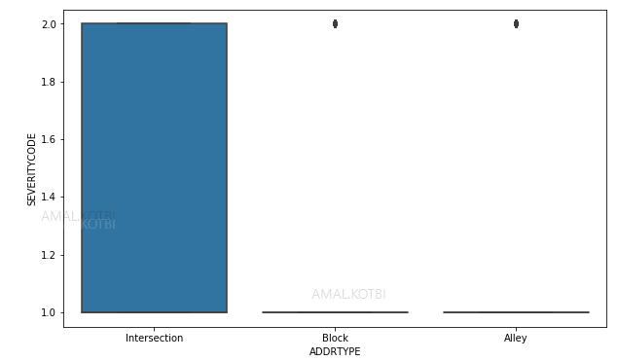
Address Type affects severity

Slide 6
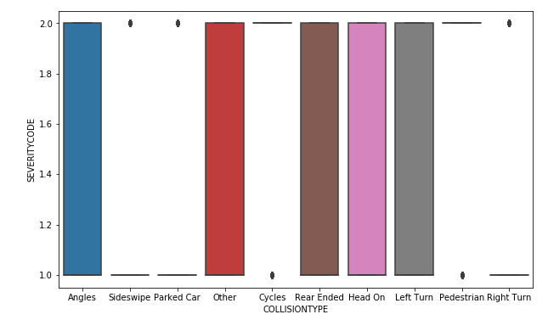
Collision Type affects severity

Slide 7
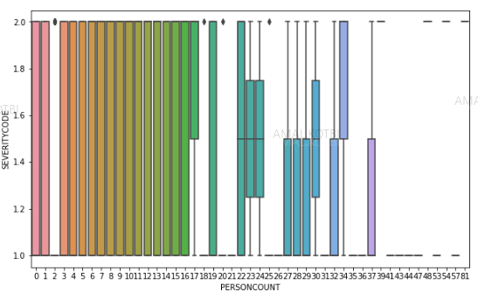
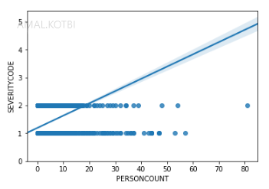
People Count affects severity

Slide 8
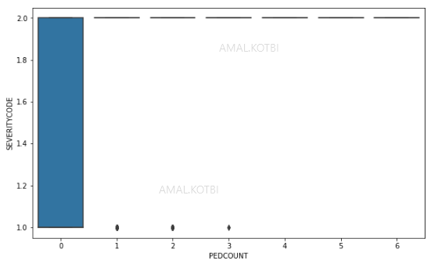
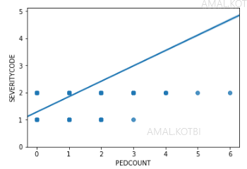
Pedestrians Count affects severity

Slide 9
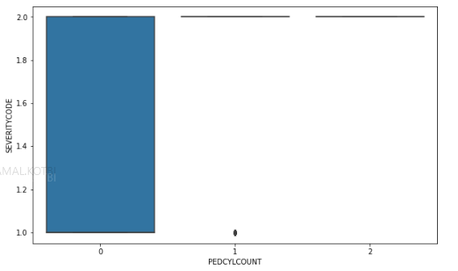
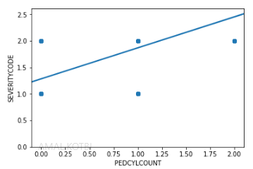
Cyclist Count affects severity

Slide 10
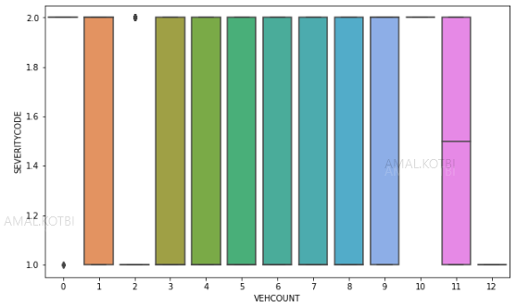
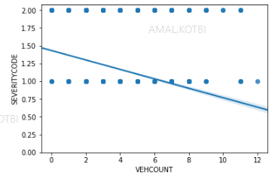
Vehicles Count affects severity

Slide 11
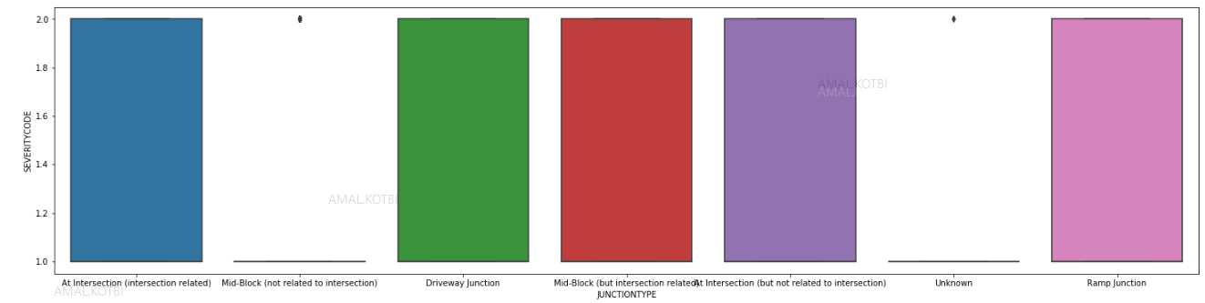
Junction Type affects severity

Slide 12
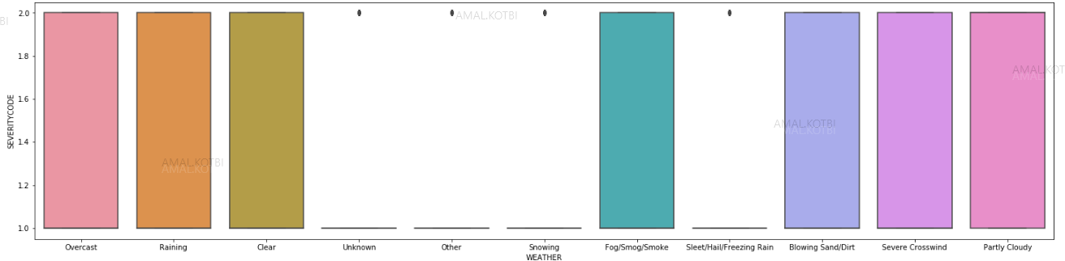
Weather Condition affect severity

Slide 13
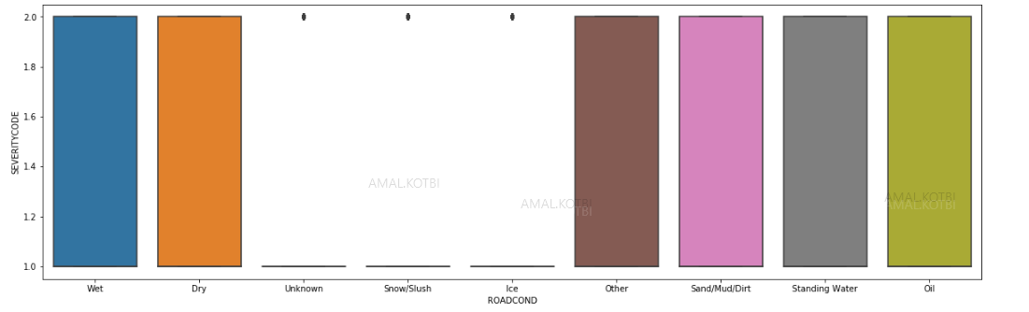
Road Condition affect severity

Slide 14
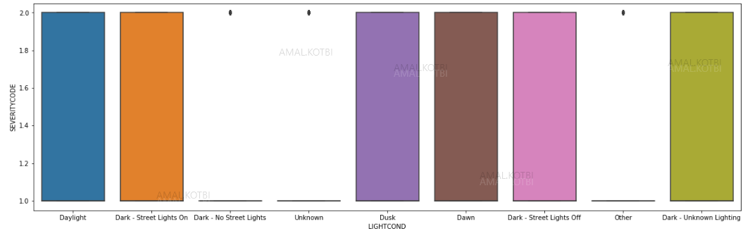
Light Condition affects severity

Slide 15
Classification Models Feature Selection
Based on Data exploratory analysis, we have selected independent features below to build our model
['ADDRTYPE','COLLISIONTYPE','PERSONCOUNT','PEDCOUNT','PEDCYLCOUNT','VEHCOUNT','JUNCTIONTYPE','SDOT_COLCODE', 'WEATHER','ROADCOND','LIGHTCOND','HITPARKEDCAR']

Slide 16
Classification Models Data Train/Test Split
In order to build the model and test its accuracy, our dataset has been divided into Train data (to train the model), and Test data (to test accuracy of the model).
Train dataset size=151815
Test dataset size= 37954

Slide 17
Classification Models Results and Accuracy
Models built using (KNN, Decision-tree, SVM, Logistic regression) and calculated model accuracy using jaccard-similarity and f1-score. Below is result of each model:
 | jaccard-similarity | f1-score
KNN | 0.744 | 0.715
Decision-Tree | 0.7494 | 0.686
SVM | 0.7609 | 0.72
Logistic regression | 0.75 | 0.7

Slide 18
Conclusions and future directions
I have analyzed the relationship between accident severity and other factors that will impact the severity of an accident
Accuracy of the model has room for improvement by having Improved data set to include:
Speeding data
Driver under influence or not
Driver didn’t pay attention

